Slide 1

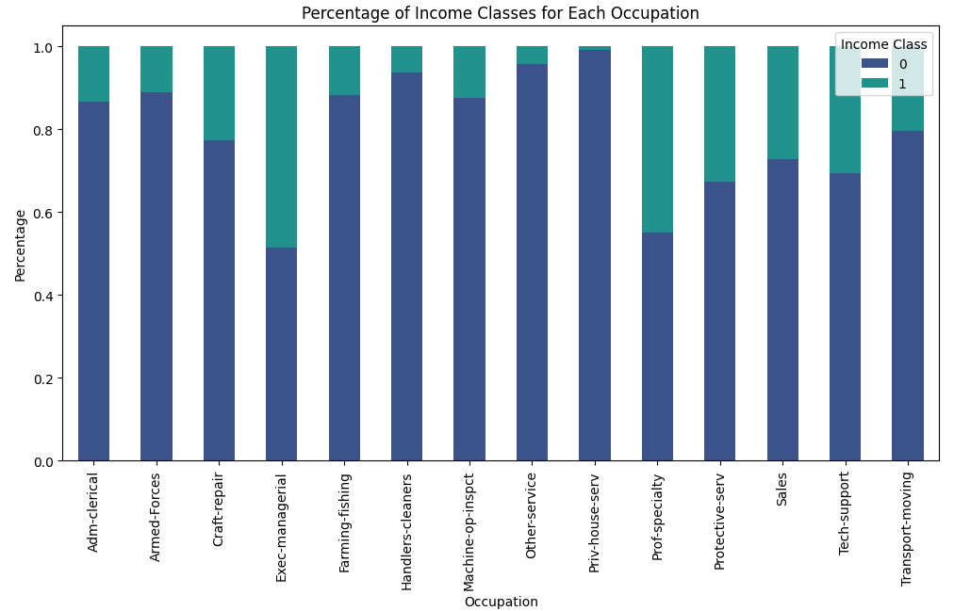

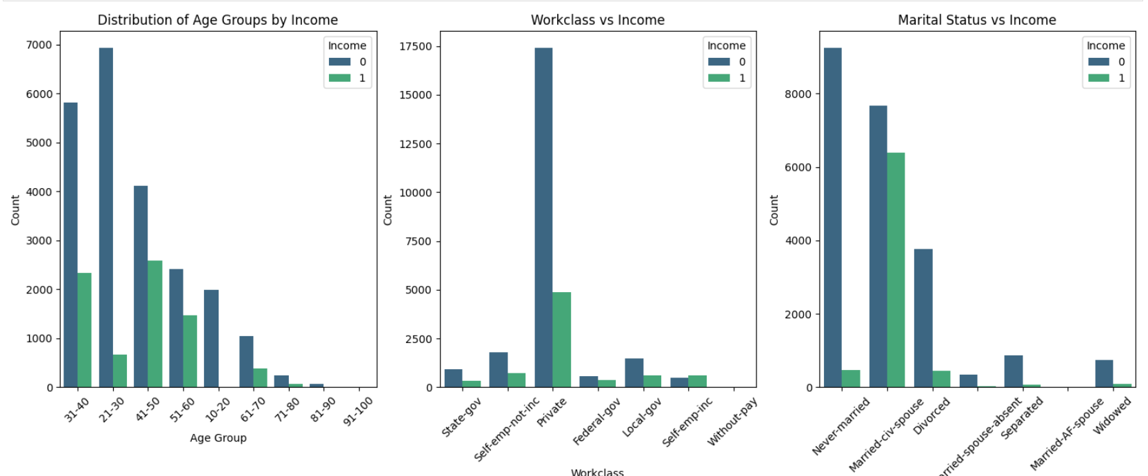
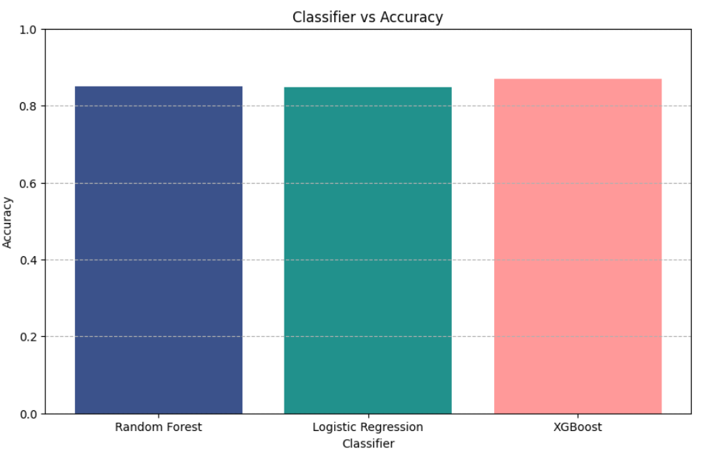


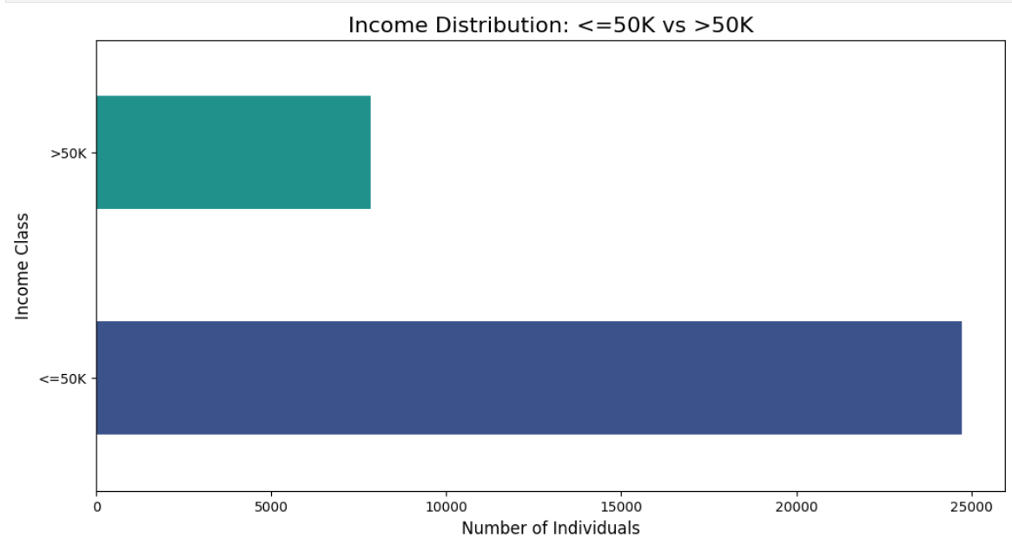
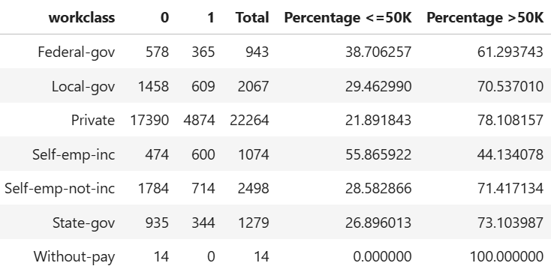
The project effectively utilized the Adult Census Income dataset to explore factors influencing income inequality, achieving an accuracy of approximately 87% with the XGBoost classifier.
PREDICTING INCOME LEVELS USING CENSUS DATA
Classification of Census Data to Predict Annual Income Above $50K.)
Tharun Teja Mogili , UB Person No. 50559877
Introduction
This project analyzes the Adult Census Income dataset to predict if an individual earns over $50,000/year using demographic factors, with a goal of achieving 85% predictive accuracy through data preprocessing and machine learning classifiers.
Data Analysis
Data visualizations like bar plots, scatter plots, and correlation matrices analyzed features such as age, work class, education, and gender, revealing patterns linked to earning over USD 50K.
Visualizations like bar and correlation matrices analyzed age, work class, and gender, revealing patterns in income over USD 50K.
Highlights a moderate positive correlation between age and capital gain, with most other features showing weak correlations.
Occupations like 'Prof-specialty' and 'Exec-managerial' are more prevalent, roles like 'Protective-serv' and 'Handlers-cleaners' are less represented.
Conclusion
The project effectively utilized the Adult Census Income dataset to explore factors influencing income inequality, achieving an accuracy of approximately 87% with the XGBoost classifier.
Evaluation metrics, including precision and recall, provided valuable insights into identifying individuals earning over USD 50,000, while visualizations highlighted significant patterns related to age, education, work class, and gender.
Future work could enhance prediction accuracy by incorporating additional features such as geographic location and exploring ensemble methods or deep learning techniques.
Methods
Dataset
The UCI Adult Dataset was used, which contains census information such as age, education, occupation, and income.
2. Data Preprocessing:
Loading: The dataset was loaded using Pandas, ensuring proper data structure for analysis.
Handling Missing Values: Missing values were addressed by replacing them with nulls and dropping affected rows.
Feature Scaling and Encoding: One-hot encoding was applied to categorical variables, and the target variable (income) was converted to binary (0 for ≤50K, 1 for >50K).
D. The analysis reveals significant income disparities among occupations, with "Exec-managerial" and "Prof-specialty" showcasing higher earnings compared to "Handlers-cleaners" and "Machine-op-inspct.“
Figure A: neque dignissim, and in aliquet nisl et umis.
Predictive Modeling
Implemented both Random Forest Classifier and XGBoost to predict whether individuals earn over USD 50K/year.
Evaluated models using classification reports and additional performance metrics.
Results
Model Performance: The predictive model achieved an accuracy of 85%, with the XGBoost classifier reaching approximately 87%.
Key Metrics: Precision for high-income earners was 73%, and recall was 62%, indicating effective identification of actual positive cases.
Average Performance: Macro average precision and recall were 80% and 77%, respectively, providing insights into income inequality patterns..
References
Becker, B. & Kohavi, R. (1996). Adult [Dataset]. UCI Machine Learning Repository.
Waskom, M. L. (2021). Seaborn: Statistical Data Visualization. Journal of Open-Source Software, 6(60), 3021. https://doi.org/10.21105/joss.03021
https://scikit-learn.org/stable/modules/generated/sklearn.ensemble.RandomForestClassifier.html
The horizontal bar chart illustrates the income distribution
The table analyzes income distribution by work class, revealing that certain classes show higher proportions of individuals earning over $50K, indicating better employment opportunities.
School of Engineering and Applied Sciences
tharunte.buffalo.edu

